Slide 1

GAS LEAKAGE DETECTION
Supervised by : Dr. Amany Magdy Mohamed
TA. Mohamed Mostafa Saad
Implemented by:
Student Name | Student ID
Nada Gamal Anwar | 20-00293
Sandra Atef Sedky | 20-00007
Magy John Bastawroos | 20-00249
Reham Hesham Kamal | 20-01057
Rahma Kamal Abdelaziz | 20-01150
Fatma Ahmed Mohamed | 20-00852
Shrouk Kadry Ahmed | 20-01383

Slide 2
Agenda
Project Idea
Why this project is made?
Problem Statement
How to solve this problem?
Related Work
Gas Sensor Dataset
Implementation
Result
Tools & Technologies
Conclusion
Future Work

Slide 3
Project Idea

Slide 4
present an innovative solution that addresses a paramount concern in the realms of safety and security.
The Gas Leakage Detection System.

Slide 5
Why this project is made?

Slide 6
Safety Concerns: Gas leaks pose severe threats to safety, health, and the environment.
Common Risks: From fire hazards to health issues, the consequences can be catastrophic.
Need for Prevention: Our motivation is rooted in the imperative to prevent incidents and safeguard lives.

Slide 7
Problem Statement

Slide 8
This Problem aims to:
The problem at hand lies in developing an advanced gas leak detection and prevention system that can accurately and efficiently detect the presence of gas leaks in various environments and immediately alert individuals or authorities to take appropriate measures to prevent potential risks. Having a system solves the problem With high accuracy and efficiency.

Slide 9
Dangerous accidents can occur as a result of gas leaks.
Many people suffer from concern about gas leakage in their homes and the harmful effects that this phenomenon can have on their health and safety.
The need for a system that can monitor and detect the number of people present in a place quickly and effectively is becoming increasingly important, to improve the level of safety and security in residential and commercial buildings. And to make people aware of the importance of gas leaks to avoid accidents and potential risks that may occur. This, with a camera and application, solves the problem with high precision and efficiency.

Slide 10
How to solve the problem?

Slide 11
The solution to the gas leakage problem is to install a sensor with a camera.
The sensor measures the gas levels in the house .
if it does not exceed the normal limit then there is no leak.
if they exceed the required limit, this means that, there is a gas leak.
The purpose of the sensor is also the speed of response and the intensity of sensitivity to the gas .

Slide 12
The camera detects whether there are people in the house or not.
The camera was used and frames were created to detect people and count them using a counter.
An application has been created that sends a notification for user in case of a gas leak in order to increase the speed of response.

Slide 13
Related Work

Slide 14

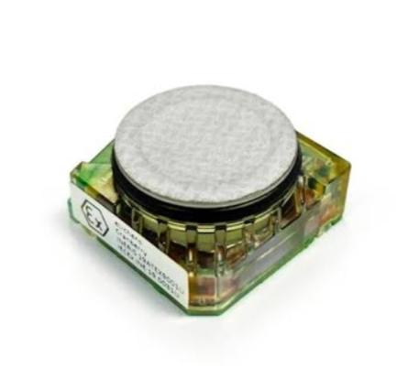
1-Low-Power, Chip-Scale, Carbon Dioxide Gas Sensors for Spacesuit Monitoring (N5 Sensors)
Enables chip-scale gas sensing. Their low-power sensor platform can be successfully implemented in mobile devices and wearables.. The sensors can detect various gases such as hydrogen, methan, CO, CO2, VOCs, etc.
2-Enhancing Air Quality Monitoring with Optical Sensors (ELichens)
Optical sensors for air quality monitoring. It focuses on the development of technology for air quality management. It offers Optical sensors that are fitted into devices and help individuals monitor the air quality.

Slide 15
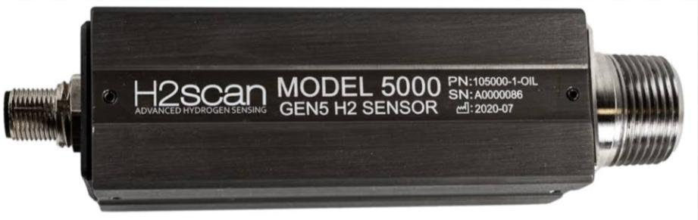
3-Advanced Thin-Film Hydrogen Sensors( H2scan)
It provides a thin-film hydrogen sensor for high-temperature and marine applications. It caters to petroleum, power grid transformer, nuclear power plant, and semiconductor industries.

Slide 16
4-A Gas Leakage Detection Device Based on the Technology of TinyML, Vasileios Tsoukas , (22 March 2023)
the system use TinyML technology to build fully independent and safe devices that can gather, analyze, and produce data, without transferring it to distant organizations.
The model used is the EI model
the model have been used is detect two types (smoke, ammonia)
The mobile application is to monitor gas leak detection devices, notify users of potential threats.
Limitations:- The model was not trained enough to determine the type of leak.

Slide 17
5-Leak Detection in Natural Gas Pipelines Using Intelligent Model,Oshingbesan Adebayo(April 2019)
The project aims to detect small leaks in natural gas pipelines by employing various data-driven intelligent models.
The best models in terms of the most sensitivity in detecting gas leaks are Random forest and decision tree.
These models were identified as the most sensitive, capable of detecting a leak of 0.1% of nominal flow within about 2 hours.
Limitations:- This paper does not contain a mobile application for alerts in case of gas leak.

Slide 18
Need to extend :
The model was trained well enough to determine the type of gas leak, because it is possible that the leak is not just gas, it may be the smell of perfume or something else.
A camera was created that records video clips to determine the presence of people in the place or not and also works to count people using a counter.
A mobile application was created to alert the user in the case of a gas leak and to respond quickly.

Slide 19
Gas Sensor Dataset

Slide 20
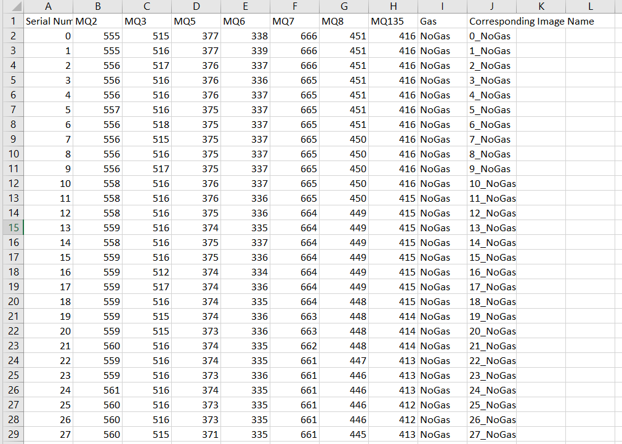

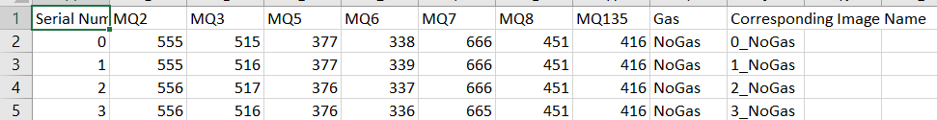
A Gas_Sensor_Measurement dataset has 6400 sample in total.
These 6400 samples divided equally in four classes.
The dataset contain 1600 samples of perfume class,1600 samples of smoke class and 1600 samples for a mixture between perfume and smoke class .
The remaining 1600 were collected for neutral environment (No Gas) class.
This dataset available on kagle:https://data.mendeley.com/datasets/zkwgkjkjn9/2
Figure 1 :Dataset
Figure 2: Dataset

Slide 21
Implementation

Slide 22
Comparsion | Extra Tree | Random Forest | K-NN | SVM | Decision Tree | Naïve Bayes | Logistic Regression
Highest Accuracy | Accuracy = 97.86% | Accuracy = 97.58% | Accuracy = 97.265% | Accuracy = 97.10% | Accuracy = 94.76% | Accuracy = 86.25% | Accuracy = 85.0%
Parameters | N-estimators=100 Random State=0 | N – estimatore =50 Criterion = "entropy" Random forest =0 | Random State=0 When K=5 | C =1000, gamma= 1, kernel='rbf' | Random State=0 Max Depth=7 | Priors=[0.2, 0.2, 0.5, 0.1] | max_iter=3000, penalty='l2', random_state=0
Distinguishing Featuers | creates many decision trees but the sampling for each tree is random without replacement | .Handling high-dimensional data. .Robustness to noise and outliers. .Handling missing values. | Lazy Learning Non-parametric Distance Metric K Value | Effectiveness in High-dimensional Spaces. Capability to Handle Non-linear data. | Interpretability Less Data Preparation Non-Parametric Versatility Non-Linearity | Probabilistic Approach computationally efficient Works Well with High-Dimensional Data | Logistic regression is easier to perform and interpret. It makes no assumptions about the distributions of classes in feature space

Slide 23
Haar Cascade:
Haar Cascade is particularly well-suited for facial detection
A video system using a normal camera that detects faces with a blue rectangular and prints the number of detected faces as text in case of a fire or gas leakage combines computer vision with real-time analytics.
Here's a brief overview:
The algorithm detects faces by first creating a Haar Cascade classifier using a set of positive and negative images
The classifier is then used to scan a new image or video for faces.
The scanning process involves sliding a window of fixed size over the image and applying the classifier to each window.
Face Detection: The camera uses computer vision algorithms to detect human faces within its field of view.

Slide 24
Real-Time Counting: Once faces are detected the system highlights it with a blue rectangular, the system counts the number of faces and continuously updates this count.
Displaying Face Count: The detected number of faces is displayed as text on the video feed or on a connected display system. This real-time text update provides an immediate count of people present.
Notification and Evacuation: If a gas leakage or fire is detected, the system triggers notification , notifies the user, and displays the count of detected faces. The blue rectangle helps in visually locating each person quickly.

Slide 25
when gas leak occurs the sensor will send notifications to the user via the application to notify him That helps to find a solution for the problem and take quick action before facing any danger, such as closing the valve, opening the windows, or evacuating the place if necessary. The application is easy to use, just making an account then the user could receive notifications and view the camera that located where the sensor is.
Flutter Application:

Slide 26



Home Screen Just click “Let’s Go” to start.
Login Screen
if user have an account he need to login, haven’t create one.
Registration Screen
The name, gender, age, email and password are required to create a new account.
Figure 3
Figure 4
Figure 5

Slide 27
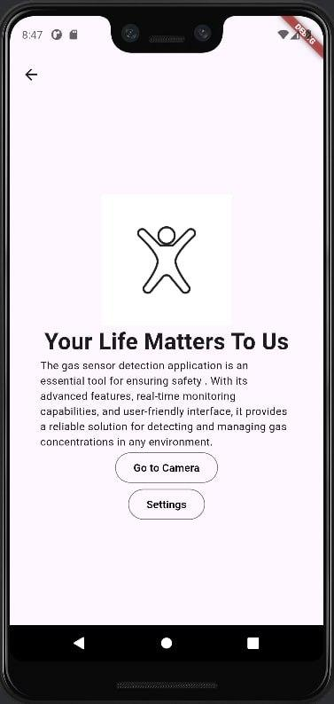
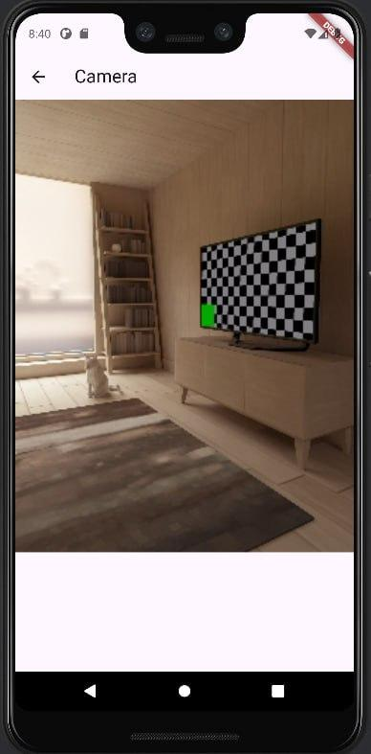

Default screen
the first page appears to user when login.
Camera Screen
view what camera see at the moment.
Settings Screen
The user can view and edit his profile and set the settings as he want.
Figure 6
Figure 7
Figure 8

Slide 28
Result

Slide 29
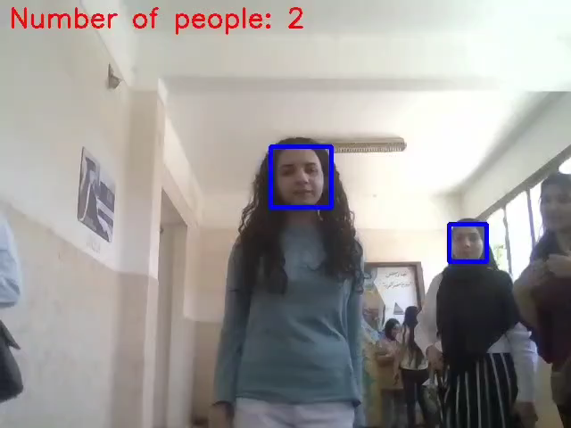
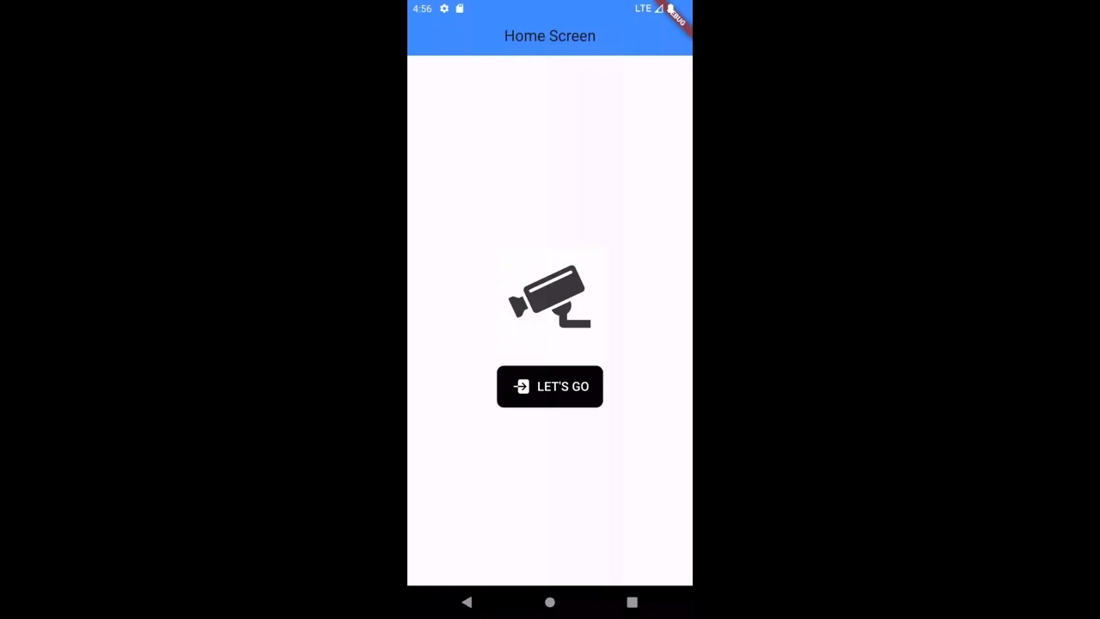
Video 1 : Normal Camera
Flutter App

Slide 30
Tools & Technologies

Slide 31
Tools:
1-python 2-Google Colab 3-Anaconda 4-Flutter SDK: Flutter 3.22.0 5-Dart: Dart 3.4.0 6-IDE: Android Studio 7-DevTools 2.34.3
Libraries:
1-pandas 2-numpy 3-matplotlib.pyplot 4-seaborn
5-sklearn.model_selection 6-sklearn.preprocessing 7- LogisticRegression
8- accuracy_score 9- import train_test_split 10-GaussianNB
11-ExtraTreesClassifier 12- classification_report 13-StandardScaler
14-svm 15-RandomizedSearchCV 16-uniform, randint
17-KNeighborsClassifier 18-classification_report 19-DecisionTreeClassifier
20-RandomForestClassifier 21-SVC 22'package:flutter/cupertino.dart’; 23-package:flutter/material.dart';
24-'package:ionicons/ionicons.dart’ 25-'../widgets/edit_item.dart';
26-package:test_test/widgets/setting_item.dart';
Machine Learning Algorithms:
1-Extra Tree Classifier 2-Random Forest 3-K Nearst_Knighbour(Knn)
4-Support Vector Machine (SVMs) 5-Decision Tree 6-Naïve Bayes
7-Logistic Regression 8-Haar Cascade

Slide 32
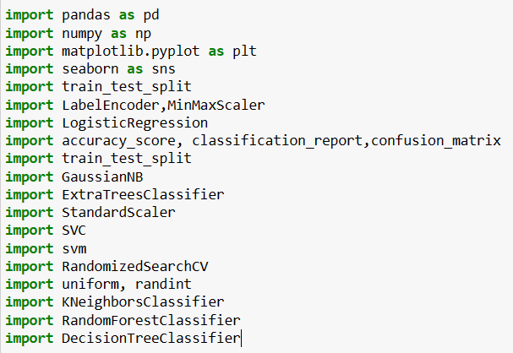
Figure 9 :Import Libraries

Slide 33
Conclusion

Slide 34
Ultimately, the system represents a pivotal advance in safety measures across industries and residential areas.
The system provides effective and reliable gas leak detection by monitoring the concentration of gases in the pipes .
Based on the data collected for the gas leakage sensors in the models and conclude Whether there is a leak or not accurately, Which contributing to safety and security for people.

Slide 35
Based on the data collected about the camera, it was detected that there were people in the place when the gas leaked.
The numbers present were identified, which allows measures to be taken at the appropriate time, via the presence of an application that connects of the camera and the sensor.
And when a gas leak occurs determining number the presence People and send alerting messages to user who downloaded the application to take appropriate measures and precautions.

Slide 36
Future Work

Slide 37
In the previous section, the implemented features were stated.
In this section the new features that could be added to application, will be introduced, plus additional points.
The main system for applications is related to future work on gas leakage and prevention.
1.A valve can be developed that automatically closes the sensor when gas leaks to prevent risks. This valve is very important for faster protection
2. Gas leak detection technology could develop in the future by using a thermal camera to measure the rate of gas leak using images.

Slide 38
Thanks

